Slide 1
Data Engineering
Warin Wattanapornprom PhD.

Slide 2
Part 2 : How data storage works?
1. Structured vs unstructured data
2. SQL
3. Data warehouse and data lakes

Slide 3
Structured data
Easy to search and organize
Consistent model, rows and columns
Defined types
Can be grouped to form relations
Stored in relational databases
Created and queried using SQL

Slide 4
Semi-structured data
Relatively easy to search and organize
Consistent model, less-rigid implementation: different observations have different sizes
Different types
Can be grouped, but needs more work
NoSQL databases: JSON, XML, YAML

Slide 5
JSON file
{
{"user_1645156":
"last_name": "Lacroix",
"first_name: "Hadrien",
"favorite_artists": ["Fools in Deed", "Gojira", "Pain", "Nanowar of Steel"]},
{"user_5913764":
"last_name": "Billen",
"first_name: "Sara",
"favorite_artists": ["Tamino", "Taylor Swift"]},
{"user_8436791":
"last_name": "Sulmont",
"first_name: "Lis",
"favorite_artists": ["Arctic Monkeys", "Rihanna", "Nina Simone"]},
...
}

Slide 6
Unstructured data
Does not follow a model, can't be contained in rows and columns
Difficult to search and organize
Usually text, sound, pictures or videos
Usually stored in data lakes, can appear in data warehouses or databases
Most of the data is unstructured
Can be extremely valuable

Slide 7
Adding some structure
Use AI to search and organize unstructured data
Add information to make it semi-structured

Slide 8
PART 2, TOPIC 2
SQL
The query language for structured data — how you actually talk to the relational databases described in the last few slides.

Slide 9
DECLARATIVE, NOT STEP-BY-STEP
Why SQL
SQL (Structured Query Language) is declarative: you describe WHAT result you want, not HOW to retrieve it
  Don’t say: seek 20 bytes onto disk, then read the next 50 bytes
  Say: select the rows where state = ‘VA’ — the database engine decides how
The engine’s query optimizer picks the retrieval plan (index scan, full scan, join order) — that is exactly the kind of automation a data engineer relies on instead of hand-rolling it
Works on structured data specifically because it has a fixed schema: SQL needs to know the columns and types in advance
Data Engineering – Part 2 (extended)

Slide 10
WHERE STRUCTURE COMES FROM
Designing a schema: CREATE TABLE
CREATE TABLE customers (
customer_id INTEGER PRIMARY KEY,
first_name VARCHAR(50) NOT NULL,
last_name VARCHAR(50) NOT NULL,
signup_date DATE NOT NULL
);
CREATE TABLE orders (
order_id INTEGER PRIMARY KEY,
customer_id INTEGER REFERENCES customers(customer_id),
order_date DATE,
amount DECIMAL(10,2)
);
PRIMARY KEY uniquely identifies a row; a data type (INTEGER, VARCHAR, DATE, DECIMAL) is fixed per column
REFERENCES declares a foreign key — orders.customer_id must exist in customers.customer_id, exactly the “tables related through common keys” idea from the Relational Database section of this deck
Data Engineering – Part 2 (extended)

Slide 11
SELECT / WHERE / ORDER BY
The anatomy of a query
SELECT first_name, last_name, amount
FROM orders
JOIN customers ON orders.customer_id = customers.customer_id
WHERE amount > 100
ORDER BY amount DESC;
SELECT — which columns to return
FROM — which table(s) to read
WHERE — filter rows before they are returned (evaluated per row)
ORDER BY — sort the result; DESC / ASC controls direction
Clauses always execute conceptually in this order: FROM → WHERE → SELECT → ORDER BY — even though SELECT is written first
Data Engineering – Part 2 (extended)

Slide 12
SUMMARIZING ROWS
Aggregation: GROUP BY and HAVING
SELECT customer_id, COUNT(*) AS order_count, SUM(amount) AS total_spent
FROM orders
GROUP BY customer_id
HAVING SUM(amount) > 500
ORDER BY total_spent DESC;
COUNT, SUM, AVG, MIN, MAX collapse many rows into one value per group
GROUP BY defines the groups — here, one row of output per customer_id
HAVING filters groups AFTER aggregation (WHERE filters rows BEFORE aggregation — they are not interchangeable)
Data Engineering – Part 2 (extended)

Slide 13
FOUR WAYS TO COMBINE ROWS
Combining tables: JOIN
INNER JOIN — only matching rows
LEFT JOIN — all of left + matches
FULL OUTER JOIN — everything
INNER JOIN keeps rows that match in both tables. LEFT JOIN keeps every row from the left table, filling unmatched right-side columns with NULL. FULL OUTER JOIN keeps everything from both sides.
In practice: 90% of joins in a data pipeline are INNER JOIN or LEFT JOIN — reach for FULL OUTER only when you specifically need to see rows missing from either side.
Data Engineering – Part 2 (extended)

Slide 14
CODE EXAMPLE
JOIN in practice
-- INNER JOIN: only customers who have placed an order
SELECT c.first_name, o.order_id, o.amount
FROM customers c
INNER JOIN orders o ON c.customer_id = o.customer_id;
-- LEFT JOIN: every customer, even those with zero orders
SELECT c.first_name, o.order_id, o.amount
FROM customers c
LEFT JOIN orders o ON c.customer_id = o.customer_id;
With LEFT JOIN, a customer with no orders still appears in the result — order_id and amount come back as NULL for that row
This distinction matters for reporting: “customers with zero orders” is a real, common business question that only a LEFT JOIN can answer directly
Data Engineering – Part 2 (extended)

Slide 15
A QUERY INSIDE A QUERY
Subqueries
-- Customers whose total spend is above the overall average
SELECT customer_id, SUM(amount) AS total_spent
FROM orders
GROUP BY customer_id
HAVING SUM(amount) > (
SELECT AVG(amount) FROM orders
);
The inner query runs first and returns a single value here (the overall average); the outer query uses it as a comparison
Subqueries can also return a list (used with IN) or a full table (used in FROM) — the same building block, three positions
Data Engineering – Part 2 (extended)

Slide 16
CREATE VIEW
Views: saving a query as a table
CREATE VIEW high_value_customers AS
SELECT customer_id, SUM(amount) AS total_spent
FROM orders
GROUP BY customer_id
HAVING SUM(amount) > 500;
SELECT * FROM high_value_customers WHERE total_spent > 1000;
A view is a saved, named query — it looks like a table to anyone querying it, but re-runs the underlying SQL each time
This is exactly the “create views on top of the database tables” responsibility already listed for data engineers earlier in this deck — now with the syntax behind it
Data Engineering – Part 2 (extended)

Slide 17
SAME OPERATIONS, TWO SYNTAXES
SQL and pandas, side by side
Operation | SQL | pandas
Filter rows | WHERE amount > 100 | df[df.amount > 100]
Select columns | SELECT first_name, amount | df[['first_name','amount']]
Sort | ORDER BY amount DESC | df.sort_values('amount', ascending=False)
Aggregate | SUM(amount) ... GROUP BY | df.groupby('id').amount.sum()
Join | a JOIN b ON a.id = b.id | a.merge(b, on='id')
The Grammar of Data section later in this deck extends this exact mapping to dplyr and more pandas verbs — same underlying operations, different backends.
Data Engineering – Part 2 (extended)

Slide 18
SUMMARY
SQL — summary
SQL is declarative — describe the result, let the query engine decide how to retrieve it
CREATE TABLE defines the schema: columns, types, primary and foreign keys
SELECT / WHERE / GROUP BY / HAVING / ORDER BY, in that logical execution order
JOIN types (INNER, LEFT, FULL OUTER) combine tables — and pick the right one for the question being asked
Subqueries and views let you build queries out of other queries
Data Engineering – Part 2 (extended)

Slide 19
Data lakes and data warehouses
Data lake
Data warehouse
Stores all the raw data
Can be petabytes (1 million GBs)
Stores all data structures
Cost-effective
Difficult to analyze
Requires an up-to-date data catalog
Used by data scientists
Big data, real-time analytics
Specific data for specific use
Relatively small
Stores mainly structured data
More costly to update
Optimized for data analysis
Also used by data analysts and business
analysts
Ad-hoc, read-only queries

Slide 20
Data catalog for data lakes
What is the source of this data?
Where is this data used?
Who is the owner of the data?
How often is this data updated?
Good practice in terms of data governance
Ensures reproducibility
No catalog --> data swamp
Good practice for any data storage
solution
Reliability
Autonomy
Scalability
Speed

Slide 21
PART 2, EXTENDED
Data Quality & Governance
A data catalog answers “where did this come from?”. This section covers “can I trust what’s in it, and who’s allowed to see it?”.

Slide 22
COST OF BAD DATA
Why data quality is a data engineering problem
Without a catalog, storage degrades into a “data swamp” — this section is about the data inside it degrading the same way, silently
A pipeline can run successfully (no exception, no failed task) and still load wrong data — schema drift, duplicate rows, or a broken upstream source produce no error, just bad output
Downstream cost compounds: a dashboard is wrong, or — as in Part 4 — a model trains on corrupted features and degrades without warning
Best practice from Part 1 (“ensure data quality by validating inputs and outputs”) needs concrete mechanisms — this section supplies them
Data Engineering – Part 2 (extended)

Slide 23
A SHARED VOCABULARY
Five dimensions of data quality
01
02
03
Accuracy
Completeness
Consistency
Does the value reflect reality? (a price of ‒09.99″ vs. ‒99.90″)
Are required fields populated, not silently NULL?
Does the same entity look the same across tables/systems?
04
05
Timeliness
Uniqueness
Is the data fresh enough for the decision it supports?
No unintended duplicate rows for the same real-world event
Pick 2–3 of these per pipeline to check automatically — trying to guarantee all five for every table is rarely worth the engineering cost.
Data Engineering – Part 2 (extended)

Slide 24
CATCH IT BEFORE IT LOADS
Schema validation and pipeline testing
# Concept: a validation step between "transform" and "load" (Part 1 ETL pattern)
def validate(df):
assert df['amount'].notnull().all(), "amount has nulls"
assert (df['amount'] >= 0).all(), "amount has negative values"
assert df['customer_id'].is_unique, "duplicate customer_id"
assert df['signup_date'].dtype == 'datetime64[ns]', "signup_date has wrong type"
# In practice: tools like Great Expectations or dbt tests express
# these same checks declaratively, and run them on every pipeline run.
This is a direct extension of the ETL pipeline from Part 1 — one more task the DAG runs before load, that fails the pipeline loudly instead of loading silently-wrong data
A validation failure should stop the DAG (fail the task) rather than continue — the same principle as the “implement error handling” best practice from Part 1
Data Engineering – Part 2 (extended)

Slide 25
EXTENDING THE DATA CATALOG
Data lineage
The data catalog (previous section) answers: source, owner, update frequency
Lineage answers one more question: exactly which upstream tables and transformation steps produced this column?
Why it matters for a data engineer specifically:
  When a number looks wrong, lineage lets you trace backward to the exact pipeline step to check
  When a source schema changes, lineage tells you every downstream table that will break
Airflow DAGs (Part 1) are themselves a form of lineage — the task graph already encodes “what fed into what”; a data catalog just needs to surface it
Data Engineering – Part 2 (extended)

Slide 26
SECURITY, CONCRETELY
Access control and PII
Principle of least privilege — a role gets exactly the access its job needs, not the whole warehouse
PII (Personally Identifiable Information) — names, national ID numbers, phone numbers, precise location — needs handling beyond a normal column:
  Masking — show only part of a value (e.g. last 4 digits) to roles that don’t need the full value
  Anonymization / pseudonymization — replace identifying values with a token before analysts ever see the table
  Encryption at rest and in transit for anything sensitive
This is a direct answer to the “ensuring data quality, consistency, and security” responsibility listed for data engineers at the start of Part 1
Data Engineering – Part 2 (extended)

Slide 27
WHY THIS IS NOT OPTIONAL
Regulatory context: PDPA and GDPR
Thailand’s Personal Data Protection Act (PDPA) and the EU’s GDPR both give individuals rights over data collected about them:
  Consent — a lawful basis is required before collecting or processing personal data
  Data minimization — collect only what is actually needed for the stated purpose
  Right to access / erasure — a person can request their data, or request it be deleted
For a data engineer, “right to erasure” is a real pipeline requirement: can a specific customer_id be deleted from every warehouse table and every upstream copy, including backups?
This is why lineage and a data catalog are not just nice-to-have — they are what makes a deletion request answerable at all
Data Engineering – Part 2 (extended)

Slide 28
SUMMARY
Data quality & governance — summary
A pipeline can run without errors and still deliver wrong data — quality needs explicit checks, not just uptime
Five dimensions to check against: accuracy, completeness, consistency, timeliness, uniqueness
Schema validation belongs inside the DAG, as a task that can fail the pipeline before bad data loads
Lineage extends the data catalog to answer “what produced this column, and what depends on it”
Access control, PII handling, and PDPA/GDPR obligations are concrete engineering requirements, not just policy
Data Engineering – Part 2 (extended)

Slide 29
Database vs. data warehouse
Database:
  General term
  Loosely defined as organized data stored and accessed on a computer
Data warehouse is a type of database
https://blog.panoply.io/postgresql-data-warehouse
https://medium.com/@fengruohang/postgres-is-eating-the-database-world-157c204dcfc4
https://www.hydra.so/blog-posts/2022-12-13-how-we-built-fastest-postgres-db-for-analytics
https://www.hydra.so/blog-posts/2022-12-13-how-we-built-fastest-postgres-db-for-analytics
https://medium.com/@wasiualhasib/postgresql-hybrid-transactional-analytical-processing-using-25292f106239

Slide 30
Data processing value
Remove unwanted data
To save memory
Convert data from one type to another
Organize data
To fit into a schema/structure
Increase productivity

Slide 31
How data engineers process data
Data manipulation, cleaning, and tidying tasks
  that can be automated
  that will always need to be done
Store data in a sanely structured database
Create views on top of the database tables
Optimizing the performance of the database

Slide 34
Parallel computing
Basis of modern data processing tools
Necessary:
  Mainly because of memory
  Also for processing power
How it works:
  Split tasks up into several smaller subtasks
  Distribute these subtasks over several computers

Slide 35
OLAP Conceptual Data Model
Goal of OLAP is to support ad-hoc querying for the business analyst
Business analysts are familiar with spreadsheets
Extend spreadsheet analysis model to work with warehouse data
Multidimensional view of data is the foundation of OLAP

Slide 36
OLTP vs. OLAP
On-Line Transaction Processing (OLTP):
  technology used to perform updates on operational or transactional systems (e.g., point of sale systems)
On-Line Analytical Processing (OLAP):
  technology used to perform complex analysis of the data in a data warehouse
    OLAP is a category of software technology that enables analysts, managers, and executives to gain insight into data through fast, consistent, interactive access to a wide variety of possible views of information that has been transformed from raw data to reflect the dimensionality of the enterprise as understood by the user. [source: OLAP Council: www.olapcouncil.org]

Slide 37
OLTP vs. OLAP
OLTP
OLAP
User
Function
DB Design
Data
View
Usage
Unit of work
Access
Operations
# Records accessed
#Users
Db size
Metric
Clerk, IT Professional
Day to day operations
Application-oriented (E-R based)
Current, Isolated
Detailed, Flat relational
Structured, Repetitive
Short, Simple transaction
Read/write
Index/hash on prim. Key
Tens
Thousands
100 MB-GB
Trans. throughput
Knowledge worker
Decision support
Subject-oriented (Star, snowflake)
Historical, Consolidated
Summarized, Multidimensional
Ad hoc
Complex query
Read Mostly
Lots of Scans
Millions
Hundreds
100GB-TB
Query throughput, response
Source: Datta, GT

Slide 38
Approaches to OLAP Servers
Multidimensional OLAP (MOLAP)
  Array-based storage structures
  Direct access to array data structures
  Example: Essbase (Arbor)
Relational OLAP (ROLAP)
  Relational and Specialized Relational DBMS to store and manage warehouse data
  OLAP middleware to support missing pieces
    Optimize for each DBMS backend
    Aggregation Navigation Logic
    Additional tools and services
  Example: Microstrategy, MetaCube (Informix)

Slide 39
MOLAP

Slide 40
Multidimensional Data
Sales Volume as a function of time, city and product
NY
LA
SF
Juice
Cola
Milk
Cream
10
47
30
12
3/1 3/2 3/3 3/4
Date

Slide 41
Operations in Multidimensional Data Model
Aggregation (roll-up)
  dimension reduction: e.g., total sales by city
  summarization over aggregate hierarchy: e.g., total sales by city and year -> total sales by region and by year
Selection (slice) defines a subcube
  e.g., sales where city = Palo Alto and date = 1/15/96
Navigation to detailed data (drill-down)
  e.g., (sales - expense) by city, top 3% of cities by average income
Visualization Operations (e.g., Pivot)

Slide 42
A Visual Operation: Pivot (Rotate)
NY
LA
SF
Month
Juice
Cola
Milk
Cream
10
Region
47
30
12
Product
3/1 3/2 3/3 3/4
Date

Slide 43
ROLAP

Slide 44
Relational DBMS as Warehouse Server
Schema design
Specialized scan, indexing and join techniques
Handling of aggregate views (querying and materialization)
Supporting query language extensions beyond SQL
Complex query processing and optimization
Data partitioning and parallelism

Slide 45
HOLAP Servers
Support multidimensional OLAP queries
Often characterized by how the underlying data stored
Relational OLAP (ROLAP) Servers
  Data stored in relational tables
  Examples: Microstrategy Intelligence Server, MetaCube (Informix/IBM)
Multidimensional OLAP (MOLAP) Servers
  Data stored in array-based structures
  Examples: Hyperion Essbase, Fusion (Information Builders)
Hybrid OLAP (HOLAP)
  Examples: PowerPlay (Cognos), Brio, Microsoft Analysis Services, Oracle Advanced Analytic Services

Slide 46
Tools: Extraction, Transformation, & Load (ETL)
Cognos Accelerator
Copy Manager, Data Migrator for SAP, PeopleSoft (Information Builders)
DataPropagator (IBM)
ETI Extract (Evolutionary Technologies)
Sagent Solution (Sagent Technology)
PowerMart (Informatica)…

Slide 47
PART 2, EXTENDED
Dimensional Modeling
The OLTP vs. OLAP comparison mentioned “star, snowflake” schemas by name — this section builds one.

Slide 48
WHY REDESIGN THE SCHEMA
From normalized OLTP to analytics-friendly OLAP
An OLTP schema (Part 2, “OLTP vs. OLAP”) is normalized: minimal duplication, optimized for fast single-row writes
That same normalization makes analytical questions slow: “total sales by region, by month, by product category” may require joining 6+ tables
Dimensional modeling deliberately denormalizes for read speed and analyst usability — the trade-off: more storage and slower writes, in exchange for simple, fast analytical queries
This is the schema design layer underneath the data warehouse concept from earlier in Part 2
Data Engineering – Part 2 (extended)

Slide 49
THE TWO BUILDING BLOCKS
Fact tables and dimension tables
MEASURES EVENTS
DESCRIBES CONTEXT
Fact table
Dimension table
One row per measured event (a sale, a click, a shipment)
Mostly numeric, additive measures: quantity, amount, duration
Foreign keys pointing out to every relevant dimension
Usually the largest table by row count
One row per real-world entity (a product, a customer, a date, a store)
Mostly descriptive, textual attributes
Relatively small, changes slowly
What you GROUP BY / filter WHERE in analysis
Data Engineering – Part 2 (extended)

Slide 50
FACT_SALES AT THE CENTER
A star schema
dim_date
dim_product
GRAIN: 1 LINE ITEM
fact_sales
date_id, product_id, customer_id, store_id, quantity, amount
dim_customer
dim_store
The grain — “one row per sales line item” — is the single most important design decision: every fact table must state its grain explicitly before any columns are added.
Data Engineering – Part 2 (extended)

Slide 51
ONE MORE NORMALIZATION STEP
Star vs. snowflake
-- Star: dim_product is flat (denormalized)
dim_product(product_id, product_name, category_name, department_name)
-- Snowflake: category is split into its own table (normalized)
dim_product(product_id, product_name, category_id)
dim_category(category_id, category_name, department_name)
Snowflake reduces redundancy (category_name stored once, not per product) at the cost of one more JOIN per query
Default recommendation: start with a star schema — it is simpler for analysts to query directly, and storage is cheap. Snowflake only the dimensions that are large and change independently.
Data Engineering – Part 2 (extended)

Slide 52
WHEN A DIMENSION ITSELF CHANGES
Slowly changing dimensions (SCD)
A dimension row is not always permanent — a customer moves city, a product changes category. What should the warehouse do?
  Type 1 — overwrite the old value
    Simple, but loses history: you can no longer ask “what was true at the time of that sale?”
  Type 2 — insert a new row with a new surrogate key and a valid date range
    Preserves history: fact rows keep pointing at the dimension row that was valid when the event happened
Choice depends on the question the business actually needs answered — “where does this customer live now” (Type 1) vs. “where did this customer live at time of purchase” (Type 2)
Data Engineering – Part 2 (extended)

Slide 53
SUMMARY
Dimensional modeling — summary
OLTP schemas are normalized for write speed; dimensional models denormalize for analytical read speed
A fact table measures events at a defined grain; dimension tables describe the who/what/when/where around them
Star schema: flat dimensions, simplest to query. Snowflake: normalized dimensions, less redundancy, more joins
Slowly changing dimensions (Type 1 overwrite vs. Type 2 history-preserving) decide whether history survives a dimension update
Data Engineering – Part 2 (extended)

Slide 54
Cloud computing
Servers on premises
Servers on the cloud
Bought
Need space
Electrical and maintenance cost
Enough power for peak moments
Processing power unused at quieter times
Rented
Don't need space
Use just the resources we need
When we need them
The closer to the user the better

Slide 55
Cloud computing for data storage
Database reliability: data replication
Risk with sensitive data

Slide 57
Multicloud
Pros
Cons
Reducing reliance on a single vendor
Cost-efficiencies
Local laws requiring certain data to be
physically present within the country
Mitigating against disasters
Cloud providers try to lock in consumers
Incompatibility
Security and governance

Slide 58
How do we engineer features from the web?
What is a relational Database?
What is the Grammar of Data?
How is this grammar implemented in Pandas?

Slide 59
Data Engineering
data: scraping, API, feature engineering, all part of EDA
compute: code, python, R, julia, spark, hadoop
storage/database: pandas, SQL, NoSQL, HBase, disk, memory
devops: AWS, docker, mesos, repeatability
product: database, web, API, viz, UI, story
Different at different scales....

Slide 60
The basic EDA workflow
Build a DataFrame from the data (ideally, put all data in this object)
Clean the DataFrame. It should have the following properties:
  Each row describes a single object
  Each column describes a property of that object
  Columns are numeric whenever appropriate
  Columns contain atomic properties that cannot be further decomposed
Explore global properties. Use histograms, scatter plots, and aggregation functions to summarize the data.
Explore group properties. Use groupby, queries, and small multiples to compare subsets of the data.

Slide 61
Relational Database
Don't say: seek 20 bytes onto disk and pick up from there. The next row is 50 bytes hence…
Say: select data from a set. I don't care where it is, just get the row to me.

Slide 62
Relational Database
A collection of tables related to each other through common data values
Rows represent attributes of something
Everything in a column is values of one attributes
A cell is expected to be atomic
Tables are related to each other if they have columns, called keys, which represent the same values

Slide 63
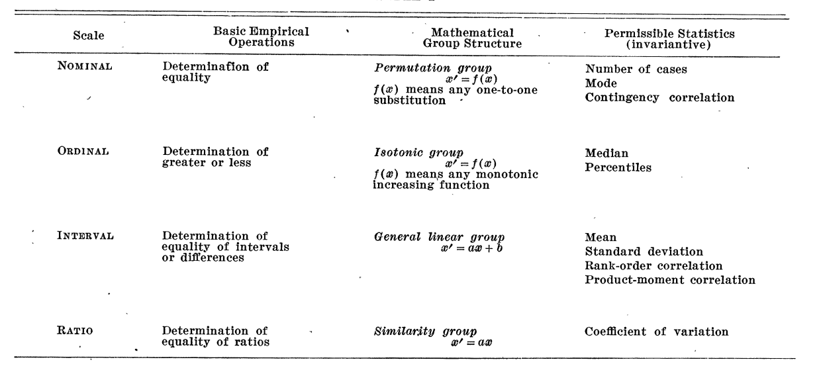
Scales of Measurement¹
Quantitative (Interval and Ratio)
Ordinal
Nominal
¹ S. S. Stevens, Science, New Series, Vol. 103, No. 2684 (Jun. 7, 1946), pp. 677-680

Slide 64
Grammar of Data

Slide 65
Grammar of Data
Been there for a while (SQL, Pandas), formalized in dplyr²
  provide simple verbs for simple things. These are functions corresponding to common data manipulation tasks.
  second idea is that backend does not matter. Here we constrain ourselves to Pandas.
  multiple backends implemented in Pandas, Spark, Impala, Pig, dplyr, ibis, blaze
² Hadley Wickham: https://dplyr.tidyverse.org/

Slide 66
Grammar of Data
Why bother?
learn how to do core data manipulations, no matter what the system is.
relational databases critical for non-memory fits.
one off questions: google, stack-overflow, http://chrisalbon.com

Slide 67
http://chrisalbon.com
For cleaning and for transformation:

Slide 68
Grammar of Data
Example: Candidates

Slide 69
Grammar of Data
Contributors

Slide 70
Grammar of Data
Operations:
QUERY: dfcwci[(dfcwci.state=='VA') & (dfcwci.amount < 400)]
SORT: dfcwci.sort_values(by="amount", ascending=False)
SELECT-COLUMNS: dfcwci[['first_name', 'amount']]
SELECT-DISTINCT: dfcwci[['last_name','first_name']].drop_duplicates()
ASSIGN: dfcwci['name']=dfcwci['last_name']+", "+dfcwci['first_name']
ASSIGN(in-place): dfcwci.loc[dfcwci.state=='VA', 'name']="junk”
AGGREGATE: dfcwci.amount.max(), dfcwci.describe()
DELETE: del dfcwci['name'] (DROPCOLUMN)

Slide 71
Grammar of Data
Split-Apply-Combine:
GROUP-AGG
splitting the data into groups based on some criteria
applying a function to each group independently
combining the results into a data structure

Slide 72
Grammar of Data
RELATIONSHIPS (in addition to rubric)
we usually need to combine data from multiple sources
different systems have different ways, most copy SQL (pandas)
sub-select:
  obamaid=dfcand.query("last_name=='Obama'")['id'].values[0]
  obamacontrib=dfcwci.query("candidate_id==%i" % obamaid)

Slide 73
Grammar of Data
JOINS:
combine tables on a common key-value
90% of the time, EXPLICIT INNER JOIN

Slide 74
Python web scraping

Slide 75
Python data scraping
Why scrape the web?
vast source of information, combine with other data sets
companies have not provided APIs
automate tasks
keep up with sites
fun!

Slide 76
Python data scraping
copyrights and permission:
  be careful and polite
  give credit
  care about media law
  don't be evil (no spam, overloading sites, etc.)

Slide 77
Python data scraping
Robots.txt
  specified by web site owner
  gives instructions to web robots (aka your script)
  is located at the top-level directory of the web server
  e.g.: http://google.com/robots.txt

Slide 78
HTML
angle brackets
should be in pairs, eg <p>Hello</p>
maybe in implicit bears, such as <br/>
<!DOCTYPE html>
<html>
  <head>
  <title>Title</title>
  </head>
  <body>
  <h1>Body Title</h1>
  <p>Body Content</p>
</body>
</html>

Slide 79
Developer Tools
ctrl/cmd shift- i in chrome
cmd-option-i in safari
look for "inspect element"
locate details of tags

Slide 80
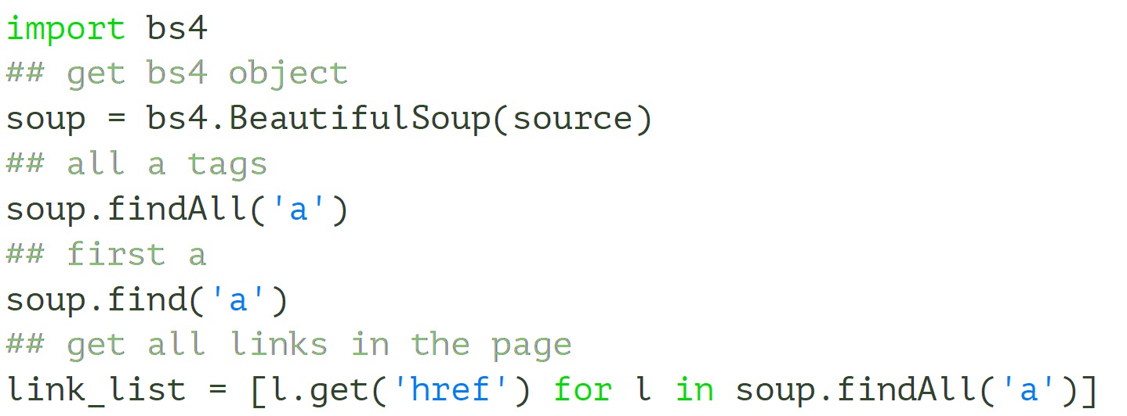
Beautiful Soup
will normalize dirty html
basic usage

Slide 81
HTML is a tree
tree = bs4.BeautifulSoup(source)
## get html root node
root_node = tree.html
## get head from root using contents
head = root_node.contents[0]
## get body from root
body = root_node.contents[1]
## could directly access body
tree.body

Slide 82
Demographics table we want

Slide 83
Table with sole class wikitable

Slide 84
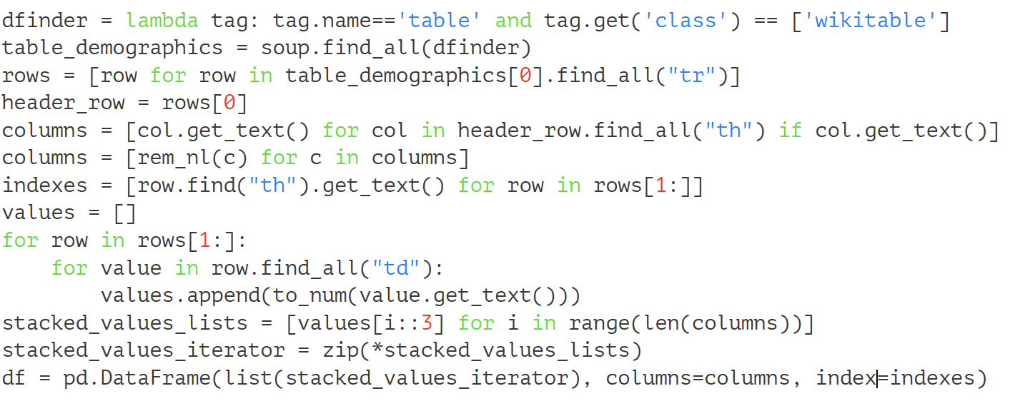
Beautiful Soup Code

