Slide 1
Data Engineering
Warin Wattanapornprom PhD.

Slide 2
Part 1 : What is data engineering?
1. Data engineering and big data
2. Data engineers vs. data scientists
3. Data pipelines

Slide 3
Part 2 : How data storage works?
1. Structured vs unstructured data
2. SQL
3. Data warehouse and data lakes

Slide 4
Part 3 : How to move and process data?
1. Processing data
2. Scheduling data
3. Parallel computing
4. Cloud computing

Slide 5
Part 4 : Beyond data engineer…
Data Scientist + Data Engineer = Machine Learning Engineer

Slide 6
Data workflow

Slide 7
Data workflow

Slide 8
Data workflow

Slide 9
Data workflow

Slide 10
Data workflow

Slide 11
Data engineers
Data engineers deliver:
the correct data
in the right form
to the right people
as efficiently as possible

Slide 12
A data engineer's responsibilities
Ingest data from different sources
Optimize databases for analysis
Remove corrupted data
Develop, construct, test and maintain data architectures
Implementing ETL processes to extract, transform, and load data
Ensuring data quality, consistency, and security
Working with data scientists and analysts to support their data needs

Slide 13
Data engineers and big data
Big data becomes the norm =>

Slide 14
Data engineers and big data
Big data becomes the norm =>data engineers are more and more needed
Big data:
  Have to think about how to deal with its size
  So large traditional methods don't work anymore

Slide 15
Big data growth
Sensors and devices
Social media
Enterprise data
VoIP (voice communication, multimedia sessions)
Data Age 2025, Seagate, 1 November 2018

Slide 16
The five Vs
Volume (how much?)
Variety (what kind?)
Velocity (how frequent?)
Veracity (how accurate?)
Value (how useful?)

Slide 17
Summary
What's waiting for you
How data flows through an organization
When a data engineer intervenes
What their responsibilities are
How data engineering relates to big data

Slide 18
Data workflow

Slide 19
Data workflow

Slide 20
Data engineers enable data scientists
Data engineer
Ingest and store data
Set up databases
Build data pipelines
Strong software skills
Data scientist
Exploit data
Access databases
Use pipeline outputs
Strong analytical skills

Slide 21
Summary
At which stages data engineers and data scientists intervene
How data engineers enable data scientists

Slide 22
If data is the new oil...
The Economist, 2017-05-1 06, by David Parkins

Slide 31
Back to data engineering
Ingest
Process
Store
Need pipelines
Automate flow from one station to the next
Provide up-to-date, accurate, relevant data

Slide 36
Data pipelines ensure an efficient flow of the data
Automate
Extracting
Transforming
Combining
Validating
Loading
Reduce
Human intervention
Errors
Time it takes data to flow

Slide 37
ETL and data pipelines
ETL
Popular framework for designing data pipelines
  Extract data (may be from various sources)
  Transform extracted data (into a suitable format for analysis)
  Load transformed data to another data warehouse or database
Data pipelines
Move data from one system to another
May follow ETL
Data may not be transformed
Data may be directly loaded in applications

Slide 38
Summary
What a data pipeline is ?
What it does ?
Why it's important ?
How data pipelines are implemented ?
What ETL is and its nuances ?

Slide 39
Tools Overview: SQL, Python, Apache Airflow
Data Engineers use a variety of tools for building data pipelines:
- SQL: Used for querying and managing relational databases
- Python: A versatile programming language for data processing and ETL scripts
- Apache Airflow: A tool for programmatically authoring, scheduling, and monitoring workflows

Slide 40
Simple ETL with Python
1. Ensure data quality by validating inputs and outputs.
2. Log each step of the pipeline to aid in debugging and monitoring.
3. Use modular functions for each stage of the pipeline to improve readability.
4. Implement error handling to gracefully manage unexpected data issues.
5. Optimize performance by choosing the right data formats and partitioning strategies.

Slide 41
Step 1: Extract Data from CSV
import pandas as pd
# Read data from a CSV file
data = pd.read_csv('sample_data.csv')
print(data.head())
This code reads the data from 'sample_data.csv' and prints the first five rows.

Slide 42
Step 2: Transform the Data
Next, we clean and normalize the data:
  Drop missing values
  Convert string columns to lowercase
  This step ensures that the data is in a consistent format for further analysis.
# Drop rows with missing values
data = data.dropna()
# Convert text columns to lowercase
data['column'] = data['column'].str.lower()

Slide 43
Step 3: Load Data into SQLite Database
We will use the `sqlite3` library to insert the cleaned data into a database:
This code creates a new database (if not already existing) and loads the transformed data into a table named 'cleaned_data'.
import sqlite3
# Create a connection to the SQLite database
conn = sqlite3.connect('data.db')
# Insert the data into a table named 'cleaned_data'
data.to_sql('cleaned_data', conn, if_exists='replace', index=False)

Slide 44
import pandas as pd
# Read data from a CSV file
data = pd.read_csv('sample_data.csv')
print(data.head())
```
# Drop rows with missing values
data = data.dropna()
# Convert text columns to lowercase
data['column'] = data['column'].str.lower()
import sqlite3
# Create a connection to the SQLite database
conn = sqlite3.connect('data.db')
# Insert the data into a table named 'cleaned_data'
data.to_sql('cleaned_data', conn, if_exists='replace', index=False)

Slide 45
Best Practices for ETL Pipelines
Ensure data quality by validating inputs and outputs.
Log each step of the pipeline to aid in debugging and monitoring.
Use modular functions for each stage of the pipeline to improve readability.
Implement error handling to gracefully manage unexpected data issues.
Optimize performance by choosing the right data formats and partitioning strategies.

Slide 46
Introduction to Apache Airflow
IN PYTH O N

Slide 47
Data Engineering
Taking any action involving data and turning it into a reliable, repeatable, and maintainable process.

Slide 48
What is a workflow?
A workflow is:
A set of steps to accomplish a given data engineering task
  Such as: downloading files, copying data, filtering information, writing to a database, etc
Of varying levels of complexity
A term with various meaning depending on context

Slide 49

What is Airflow?
Airflow is a platform to program workflows, including:
Creation
Scheduling
Monitoring

Slide 50
What is Airflow?
Can implement programs from any language, but workflows are written in Python
Implements workflows as DAGs: Directed Acyclic Graphs
Accessed via code, command-line, or via web interface / REST API
https://airflow.apache.1 org/docs/stable/

Slide 51


Other workflow tools
Luigi
SSIS
Bash scripting

Slide 52
Directed Acyclic Graph (DAG)
In Airflow, this represents the set of tasks that make up your workflow.
Consists of the tasks and the dependencies between tasks.
Created with various details about the DAG, including the name, start date, owner, etc.
Further depth in the next lesson.

Slide 53
DAG code example
Simple DAG definition:
etl_dag = DAG(
dag_id='etl_pipeline',
default_args={"start_date": "2024-01-08"}
)

Slide 54
Running a workflow in Airflow
Running a simple Airflow task
Using a DAG named example-etl, a task named download-file on 2024-01-10:
airflow tasks test <dag_id> <task_id> [execution_date]
airflow tasks test example-etl download-file 2024-01-10

Slide 55
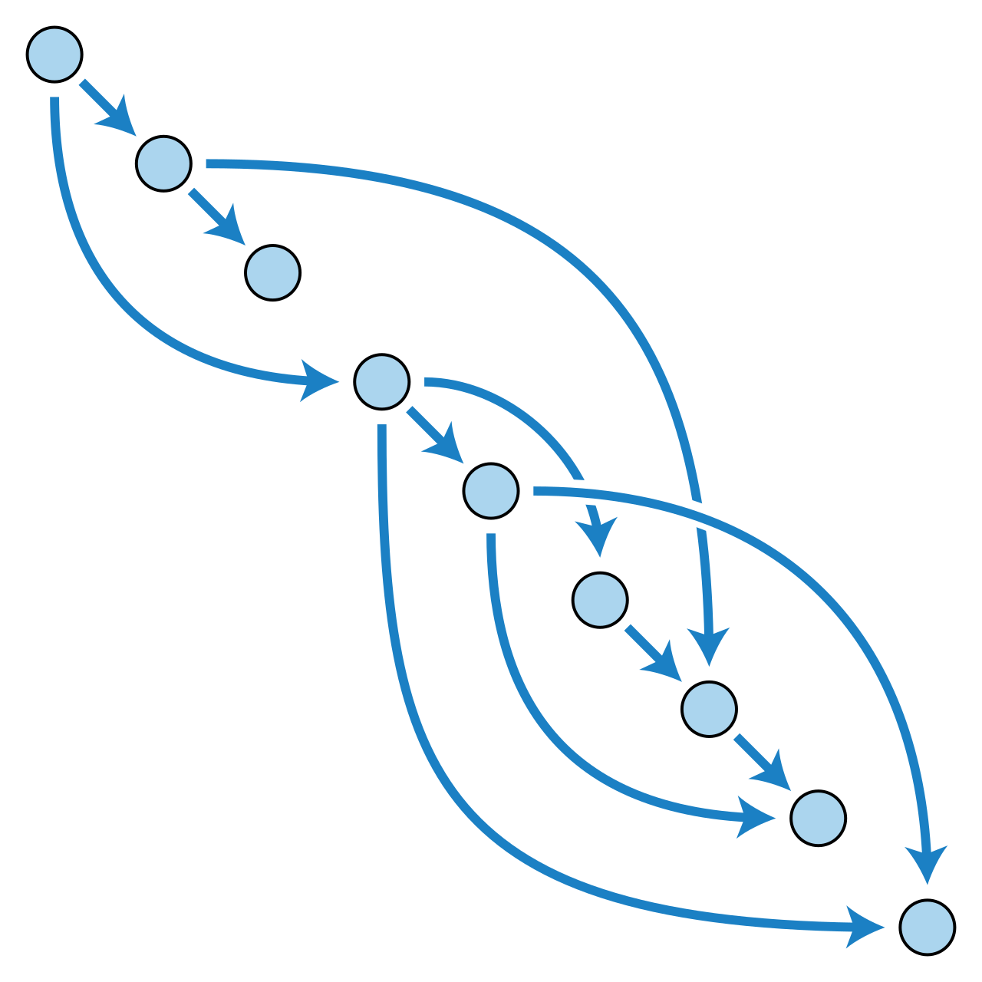
DAG
DAG, or Directed Acyclic Graph:
Directed, there is an inherent flow representing dependencies between components.
Acyclic, does not loop / cycle / repeat.
Graph, the actual set of components.
Seen in Airflow, Apache Spark, dbt
https://en.m.wikipedia.org/wiki/Directed_acyclic_graph

Slide 56
DAG in Airflow
Are written in Python (but can use components written in other languages).
Are made up of components (typically tasks) to be executed, such as operators, sensors, etc.
Contain dependencies defined explicitly or implicitly.
  ie, Copy the file to the server before trying to import it to the database service.

Slide 57
Define a DAG
from airflow import DAG
from datetime import datetime
default_arguments = {
'owner': 'warin',
'email': 'warin@kmutt.ac.th',
'start_date': datetime(2024, 9, 24)
}
with DAG('etl_workflow', default_args=default_arguments ) as etl_dag:

Slide 58
DAGs on the command line
Using airflow :
The airflow command line program contains many subcommands.
airflow -h for descriptions.
Many are related to DAGs.
airflow dags list to show all recognized DAGs.

Slide 59
Command line vs Python
Use the command line tool to:
Start Airflow processes
Manually run DAGs / Tasks
Get logging information from Airflow
Use Python to:
Create a DAG
Edit the individual properties of a DAG

Slide 60
Airflow web interface
airflow webserver -p 9090

Slide 61
DAGs view

Slide 62
DAGs view DAGs

Slide 63
DAGs view owner

Slide 64
DAGs view runs

Slide 65
DAGs view schedule

Slide 66
DAGs view last run

Slide 67
DAGs view next run

Slide 68
DAGs view recent tasks

Slide 69
DAGs view example_dag

Slide 70
DAG detail view

Slide 71
DAG graph view

Slide 72
DAG code view

Slide 73
Audit logs

Slide 74
Web UI vs command line
Equally powerful depending on needs
Web UI is easier
Command line tool may be easier to access depending on settings

Slide 75
from airflow import DAG
from airflow.operators.bash import BashOperator
from airflow.operators.python import PythonOperator
from airflow.providers.http.operators import http
import sys
def python_version():
return sys.version
with DAG(
'update_state',
default_args={"start_date": "2024-10-10"}
):
part1 = BashOperator(
task_id='generate_random_number',
bash_command='echo $RANDOM',
)
part2 = PythonOperator(
task_id='get_python_version',
python_callable=python_version,
)
part3 = http.SimpleHttpOperator(
task_id='query_server_for_external_ip',
endpoint='https://api.ipify.org',
method='GET',
)
part3 >> part2

Slide 76
Airflow Operators
Operators
Represent a single task in a workflow.
Run independently (usually).
Generally do not share information.
Various operators to perform different tasks.
# New way, Airflow 2.x+
EmptyOperator(task_id='example')

Slide 77
BashOperator
BashOperator(
task_id='bash_example',
bash_command='echo "Example!"',
)
Executes a given Bash command or script.
Runs the command in a temporary directory.
Can specify environment variables for the command.
BashOperator(
task_id='bash_script_example',
bash_command='runcleanup.sh',
)

Slide 78
BashOperator examples
from airflow.operators.bash import BashOperator
example_task = BashOperator(task_id='bash_ex',bash_command='echo 1',)
bash_task = BashOperator(task_id='clean_addresses',bash_command='cat addresses.txt | awk "NF==10" > cleaned.txt',)

Slide 79
Operator gotchas
Not guaranteed to run in the same location / environment.
May require extensive use of Environment variables.
Can be difficult to run tasks with elevated privileges.

Slide 80
Airflow tasks
Tasks are:
Instances of operators
Usually assigned to a variable in Python
Referred to by the task_id within the Airflow tools
example_task = BashOperator(task_id='bash_example', bash_command='echo "Example!"')

Slide 81
Task dependencies
Define a given order of task completion
Are not required for a given workflow, but usually present in most
Are referred to as upstream or downstream tasks
In Airflow 1.8 and later, are defined using the bitshift operators
  >>, or the upstream operator
  <<, or the downstream operator

Slide 82
Simple task dependency
# Define the tasks
task1 = BashOperator(task_id='first_task',
bash_command='echo 1'
)
task2 = BashOperator(task_id='second_task',
bash_command='echo 2'
)
# Set first_task to run before second_task
task1 >> task2 # or task2 << task1

Slide 83
Task dependencies in the Airflow UI

Slide 84
Multiple dependencies
Chained dependencies:
Mixed dependencies:
or:
task1 >> task2 >> task3 >> task4
task1 >> task2 << task3
task1 >> task2
task3 >> task2

Slide 85
PythonOperator
Executes a Python function / callable
Operates similarly to the BashOperator, with more options
Can pass in arguments to the Python code
from airflow.operators.python import PythonOperator
def printme():
print("This goes in the logs!")
python_task = PythonOperator(
task_id='simple_print',
python_callable=printme
)

Slide 86
Arguments
Supports arguments to tasks
  Positional
  Keyword
Use the op_kwargs dictionary
def sleep(length_of_time):
time.sleep(length_of_time)
sleep_task = PythonOperator(
task_id='sleep',
python_callable=sleep,
op_kwargs={'length_of_time': 5}
)

Slide 87
EmailOperator
Found in the airflow.operators library
Sends an email
Can contain typical components
  HTML content
  Attachments
Does require the Airflow system to be configured with email server details

Slide 88
EmailOperator example
from airflow.operators.email import EmailOperator
email_task = EmailOperator(
task_id='email_sales_report',
to='sales_manager@example.com',
subject='Automated Sales Report',
html_content='Attached is the latest sales report',
files='latest_sales.xlsx'
)

Slide 89
Airflow scheduling
DAG Runs
A specific instance of a workflow at a point in time
Can be run manually or via schedule_interval
Maintain state for each workflow and the tasks within
  running
  failed
  success
https://airflow.apache.org/docs/stable/scheduler.html

Slide 90
DAG Runs view

Slide 91
DAG Runs state

Slide 92
Schedule details
When scheduling a DAG, there are several attributes of note:
start_date - The date / time to initially schedule the DAG run
end_date - Optional attribute for when to stop running new DAG instances
max_tries - Optional attribute for how many attempts to make
schedule_interval - How often to run

Slide 93
Schedule interval
schedule_interval represents:
How often to schedule the DAG
Between the start_date and end_date
Can be defined via cron style syntax or via built-in presets.

Slide 94
cron syntax
Is pulled from the Unix cron format
Consists of 5 fields separated by a space
An asterisk * represents running for every interval (ie, every minute, every day, etc)
Can be comma separated values in fields for a list of values

Slide 95
cron examples
0 12 * * * # Run daily at noon
* * 25 2 * # Run once per minute on February 25
0,15,30,45 * * * * # Run every 15 minutes

Slide 96
Airflow scheduler presets
Preset:
@hourly
@daily
@weekly
@monthly
@yearly
cron equivalent:
0 * * * *
0 0 * * *
0 0 * * 0
0 0 1 * *
0 0 1 1 *

Slide 97
Special presets
Airflow has two special schedule_interval presets:
None - Don't schedule ever, used for manually triggered DAGs
@once - Schedule only once

Slide 98
schedule_interval issues
When scheduling a DAG, Airflow will:
Use the start_date as the earliest possible value
Schedule the task at start_date + schedule_interval
This means the earliest starting time to run the DAG is on February 26th, 2020
'start_date': datetime(2020, 2, 25),
'schedule_interval': @daily

Slide 99
Airflow sensors
What is a sensor?
An operator that waits for a certain condition to be true
  Creation of a file
  Upload of a database record
  Certain response from a web request
Can define how often to check for the condition to be true
Are assigned to tasks

Slide 100
Sensor details
Derived from airflow.sensors.base_sensor_operator
Sensor arguments:
mode - How to check for the condition
  mode='poke' - The default, run repeatedly
  mode='reschedule' - Give up task slot and try again later
poke_interval - How often to wait between checks
timeout - How long to wait before failing task
Also includes normal operator attributes

Slide 101
File sensor
Is part of the airflow.sensors library
Checks for the existence of a file at a certain location
Can also check if any files exist within a directory
from airflow.sensors.filesystem import FileSensor
file_sensor_task = FileSensor(task_id='file_sense',
filepath='salesdata.csv',
poke_interval=300,
dag=sales_report_dag)
init_sales_cleanup >> file_sensor_task >> generate_report

Slide 102
Other sensors
ExternalTaskSensor - wait for a task in another DAG to complete
HttpSensor - Request a web URL and check for content
SqlSensor - Runs a SQL query to check for content
Many others in airflow.sensors and airflow.providers.*.sensors

Slide 103
Why sensors?
Use a sensor...
Uncertain when it will be true
If failure not immediately desired
To add task repetition without loops

Slide 104
Airflow executors
What is an executor?
Executors run tasks
Different executors handle running the tasks differently
Example executors:
  SequentialExecutor
  LocalExecutor
  KubernetesExecutor

Slide 105
SequentialExecutor
The default Airflow executor
Runs one task at a time
Useful for debugging
While functional, not really recommended for production

Slide 106
LocalExecutor
Runs on a single system
Treats tasks as processes
Parallelism defined by the user
Can utilize all resources of a given host system

Slide 107
KubernetesExecutor
Uses a Kubernetes as task manager
Multiple worker systems can be defined
Is significantly more difficult to setup & configure
Extremely powerful method for organizations with extensive workflows

Slide 108
Determine your executor
Via the airflow.cfg file
Look for the executor= line

Slide 109
Determine your executor #2
Via the first few lines of airflow info
executor | SequentialExecutor

Slide 110
Debugging and troubleshooting in Airflow
Typical issues...
DAG won't run on schedule
DAG won't load
Syntax errors

Slide 111
DAG won't run on schedule
Check if scheduler is running
Fix by running airflow scheduler from the command-line.

Slide 112
DAG won't run on schedule (part 2)
At least one schedule_interval hasn't passed.
  Modify the attributes to meet your requirements.
Not enough tasks free within the executor to run.
  Change executor type
  Add system resources
  Add more systems
  Change DAG scheduling

Slide 113
DAG won't load
DAG not in web UI
DAG not in airflow dags list
Possible solutions
Verify DAG file is in correct folder
Determine the DAGs folder via airflow.cfg
Note, the folder must be an absolute path

Slide 114
Syntax errors
The most common reason a DAG file won't appear
Sometimes difficult to find errors in DAG
Two quick methods:
  Run airflow dags list-import-errors
  Run python3 <dagfile.py>

Slide 115
airflow dags list-import-errors

Slide 116
Running the Python interpreter
python3 dagfile.py :
With errors
Without errors

Slide 117
SLAs and reporting in Airflow
What is an SLA?
An SLA stands for Service Level Agreement
Within Airflow, the amount of time a task or a DAG should require to run
An SLA Miss is any time the task / DAG does not meet the expected timing
If an SLA is missed, an email is sent out and a log is stored.
You can view SLA misses in the web UI.

Slide 118
SLA Misses

Slide 119
Defining SLAs
Using the 'sla' argument on the task
On the default_args dictionary
task1 = BashOperator(task_id='sla_task',
bash_command='runcode.sh',
sla=timedelta(seconds=30),
dag=dag)
default_args={
'sla': timedelta(minutes=20),
'start_date': datetime(2023,2,20)
}
dag = DAG('sla_dag', default_args=default_args)

Slide 120
timedelta object
In the datetime library
Accessed via from datetime import timedelta
Takes arguments of days, seconds, minutes, hours, and weeks
timedelta(seconds=30)
timedelta(weeks=2)
timedelta(days=4, hours=10, minutes=20, seconds=30)

Slide 121
General reporting
Options for success / failure / error
Keys in the default_args dictionary
Within DAGs from the EmailOperator
default_args={
'email': ['airflowalerts@datacamp.com'],
'email_on_failure': True,
'email_on_retry': False,
'email_on_success': True,
...
}

Slide 122
Working with templates
What are templates?
Allow substituting information during a DAG run
Provide added flexibility when defining tasks
Are created using the Jinja templating language

Slide 123
Non-Templated BashOperator example
Create a task to echo a list of files:
t1 = BashOperator(
task_id='first_task',
bash_command='echo "Reading file1.txt"',
dag=dag)
t2 = BashOperator(
task_id='second_task',
bash_command='echo "Reading file2.txt"',
dag=dag)

Slide 124
Templated BashOperator example
templated_command="""
echo "Reading {{ params.filename }}"
"""
t1 = BashOperator(task_id='template_task',
bash_command=templated_command,
params={'filename': 'file1.txt'},
dag=example_dag)
Output:
Reading file1.txt

Slide 125
Templated BashOperator example (continued)
templated_command="""
echo "Reading {{ params.filename }}"
"""
t1 = BashOperator(task_id='template_task',
bash_command=templated_command,
params={'filename': 'file1.txt'},
dag=example_dag)
t2 = BashOperator(task_id='template_task',
bash_command=templated_command,
params={'filename': 'file2.txt'},
dag=example_dag)

Slide 126
More advanced template
templated_command="""
{% for filename in params.filenames %}
echo "Reading {{ filename }}"
{% endfor %}
"""
t1 = BashOperator(task_id='template_task',
bash_command=templated_command,
params={'filenames': ['file1.txt', 'file2.txt']},
dag=example_dag)
Reading file1.txt
Reading file2.txt

Slide 127
Branching
Branching in Airflow:
Provides conditional logic
Using BranchPythonOperator
from airflow.operators.python import BranchPythonOperator
Takes a python_callable to return the next task id (or list of ids) to follow

Slide 128
Branching example
def branch_test(**kwargs):
if int(kwargs['ds_nodash']) % 2 == 0:
return 'even_day_task'
else:
return 'odd_day_task'

Slide 129
Branching example
def branch_test(**kwargs):
if int(kwargs['ds_nodash']) % 2 == 0:
return 'even_day_task'
else:
return 'odd_day_task'
branch_task = BranchPythonOperator(task_id='branch_task',dag=dag,
provide_context=True,
python_callable=branch_test)
start_task >> branch_task >> even_day_task >> even_day_task2
branch_task >> odd_day_task >> odd_day_task2

Slide 130
Branching graph view

Slide 131
Branching even days

Slide 132
Branching odd days

Slide 133
Creating a production pipeline
Running DAGs & Tasks
To run a specific task from command-line:
To run a full DAG:
airflow tasks test <dag_id> <task_id> <date>
airflow dags trigger -e <date> <dag_id>

Slide 134
What we've learned
Workflows / DAGs
Operators (BashOperator, PythonOperator,
EmailOperator)
Tasks
Dependencies / Bitshift operators
Sensors
Scheduling
SLAs / Alerting
Templates
Branching
Airflow command line / UI
Airflow executors
Debugging / Troubleshooting

