Slide 1
Data Engineering
Warin Wattanapornprom PhD.

Slide 2
Part 2 : How data storage works?
1. Structured vs unstructured data
2. SQL
3. Data warehouse and data lakes

Slide 3
Structured data
Easy to search and organize
Consistent model, rows and columns
Defined types
Can be grouped to form relations
Stored in relational databases
Created and queried using SQL

Slide 4
Semi-structured data
Relatively easy to search and organize
Consistent model, less-rigid implementation: different observations have different sizes
Different types
Can be grouped, but needs more work
NoSQL databases: JSON, XML, YAML

Slide 5
JSON file
{
{"user_1645156":
"last_name": "Lacroix",
"first_name: "Hadrien",
"favorite_artists": ["Fools in Deed", "Gojira", "Pain", "Nanowar of Steel"]},
{"user_5913764":
"last_name": "Billen",
"first_name: "Sara",
"favorite_artists": ["Tamino", "Taylor Swift"]},
{"user_8436791":
"last_name": "Sulmont",
"first_name: "Lis",
"favorite_artists": ["Arctic Monkeys", "Rihanna", "Nina Simone"]},
...
}

Slide 6
Unstructured data
Does not follow a model, can't be contained in rows and columns
Difficult to search and organize
Usually text, sound, pictures or videos
Usually stored in data lakes, can appear in data warehouses or databases
Most of the data is unstructured
Can be extremely valuable

Slide 7
Adding some structure
Use AI to search and organize unstructured data
Add information to make it semi-structured

Slide 8
Data lakes and data warehouses
Data lake
Data warehouse
Stores all the raw data
Can be petabytes (1 million GBs)
Stores all data structures
Cost-effective
Difficult to analyze
Requires an up-to-date data catalog
Used by data scientists
Big data, real-time analytics
Specific data for specific use
Relatively small
Stores mainly structured data
More costly to update
Optimized for data analysis
Also used by data analysts and business
analysts
Ad-hoc, read-only queries

Slide 9
Data catalog for data lakes
What is the source of this data?
Where is this data used?
Who is the owner of the data?
How often is this data updated?
Good practice in terms of data governance
Ensures reproducibility
No catalog --> data swamp
Good practice for any data storage
solution
Reliability
Autonomy
Scalability
Speed

Slide 10
Database vs. data warehouse
Database:
  General term
  Loosely defined as organized data stored and accessed on a computer
Data warehouse is a type of database
https://blog.panoply.io/postgresql-data-warehouse
https://medium.com/@fengruohang/postgres-is-eating-the-database-world-157c204dcfc4
https://www.hydra.so/blog-posts/2022-12-13-how-we-built-fastest-postgres-db-for-analytics
https://www.hydra.so/blog-posts/2022-12-13-how-we-built-fastest-postgres-db-for-analytics
https://medium.com/@wasiualhasib/postgresql-hybrid-transactional-analytical-processing-using-25292f106239

Slide 11
Data processing value
Remove unwanted data
To save memory
Convert data from one type to another
Organize data
To fit into a schema/structure
Increase productivity

Slide 12
How data engineers process data
Data manipulation, cleaning, and tidying tasks
  that can be automated
  that will always need to be done
Store data in a sanely structured database
Create views on top of the database tables
Optimizing the performance of the database

Slide 13
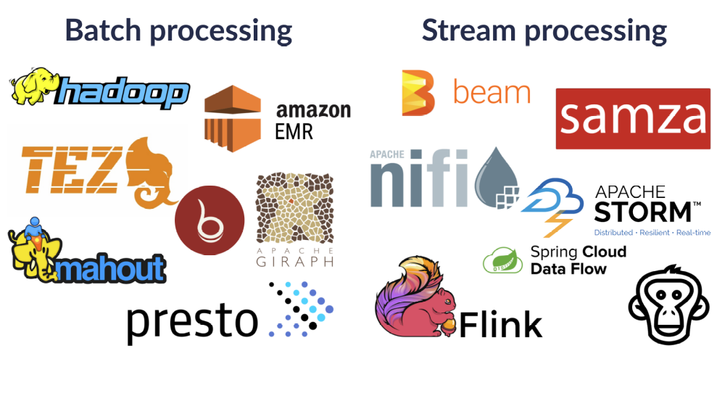

Slide 14


Slide 15
Parallel computing
Basis of modern data processing tools
Necessary:
  Mainly because of memory
  Also for processing power
How it works:
  Split tasks up into several smaller subtasks
  Distribute these subtasks over several computers

Slide 16
OLAP Conceptual Data Model
Goal of OLAP is to support ad-hoc querying for the business analyst
Business analysts are familiar with spreadsheets
Extend spreadsheet analysis model to work with warehouse data
Multidimensional view of data is the foundation of OLAP

Slide 17
OLTP vs. OLAP
On-Line Transaction Processing (OLTP):
  technology used to perform updates on operational or transactional systems (e.g., point of sale systems)
On-Line Analytical Processing (OLAP):
  technology used to perform complex analysis of the data in a data warehouse
    OLAP is a category of software technology that enables analysts, managers, and executives to gain insight into data through fast, consistent, interactive access to a wide variety of possible views of information that has been transformed from raw data to reflect the dimensionality of the enterprise as understood by the user. [source: OLAP Council: www.olapcouncil.org]

Slide 18
OLTP vs. OLAP
OLTP
OLAP
User
Function
DB Design
Data
View
Usage
Unit of work
Access
Operations
# Records accessed
#Users
Db size
Metric
Clerk, IT Professional
Day to day operations
Application-oriented (E-R based)
Current, Isolated
Detailed, Flat relational
Structured, Repetitive
Short, Simple transaction
Read/write
Index/hash on prim. Key
Tens
Thousands
100 MB-GB
Trans. throughput
Knowledge worker
Decision support
Subject-oriented (Star, snowflake)
Historical, Consolidated
Summarized, Multidimensional
Ad hoc
Complex query
Read Mostly
Lots of Scans
Millions
Hundreds
100GB-TB
Query throughput, response
Source: Datta, GT

Slide 19
Approaches to OLAP Servers
Multidimensional OLAP (MOLAP)
  Array-based storage structures
  Direct access to array data structures
  Example: Essbase (Arbor)
Relational OLAP (ROLAP)
  Relational and Specialized Relational DBMS to store and manage warehouse data
  OLAP middleware to support missing pieces
    Optimize for each DBMS backend
    Aggregation Navigation Logic
    Additional tools and services
  Example: Microstrategy, MetaCube (Informix)

Slide 20
MOLAP

Slide 21
Multidimensional Data
Sales Volume as a function of time, city and product
NY
LA
SF
Juice
Cola
Milk
Cream
10
47
30
12
3/1 3/2 3/3 3/4
Date

Slide 22
Operations in Multidimensional Data Model
Aggregation (roll-up)
  dimension reduction: e.g., total sales by city
  summarization over aggregate hierarchy: e.g., total sales by city and year -> total sales by region and by year
Selection (slice) defines a subcube
  e.g., sales where city = Palo Alto and date = 1/15/96
Navigation to detailed data (drill-down)
  e.g., (sales - expense) by city, top 3% of cities by average income
Visualization Operations (e.g., Pivot)

Slide 23
A Visual Operation: Pivot (Rotate)
NY
LA
SF
Month
Juice
Cola
Milk
Cream
10
Region
47
30
12
Product
3/1 3/2 3/3 3/4
Date

Slide 24
ROLAP

Slide 25
Relational DBMS as Warehouse Server
Schema design
Specialized scan, indexing and join techniques
Handling of aggregate views (querying and materialization)
Supporting query language extensions beyond SQL
Complex query processing and optimization
Data partitioning and parallelism

Slide 26
HOLAP Servers
Support multidimensional OLAP queries
Often characterized by how the underlying data stored
Relational OLAP (ROLAP) Servers
  Data stored in relational tables
  Examples: Microstrategy Intelligence Server, MetaCube (Informix/IBM)
Multidimensional OLAP (MOLAP) Servers
  Data stored in array-based structures
  Examples: Hyperion Essbase, Fusion (Information Builders)
Hybrid OLAP (HOLAP)
  Examples: PowerPlay (Cognos), Brio, Microsoft Analysis Services, Oracle Advanced Analytic Services

Slide 27
Tools: Extraction, Transformation, & Load (ETL)
Cognos Accelerator
Copy Manager, Data Migrator for SAP, PeopleSoft (Information Builders)
DataPropagator (IBM)
ETI Extract (Evolutionary Technologies)
Sagent Solution (Sagent Technology)
PowerMart (Informatica)…

Slide 28
Cloud computing
Servers on premises
Servers on the cloud
Bought
Need space
Electrical and maintenance cost
Enough power for peak moments
Processing power unused at quieter times
Rented
Don't need space
Use just the resources we need
When we need them
The closer to the user the better

Slide 29
Cloud computing for data storage
Database reliability: data replication
Risk with sensitive data

Slide 30
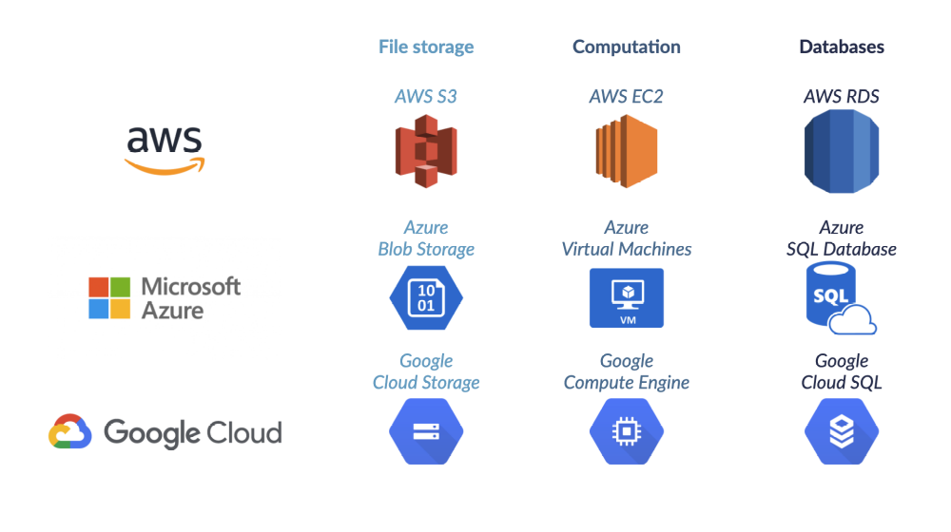

Slide 31
Multicloud
Pros
Cons
Reducing reliance on a single vendor
Cost-efficiencies
Local laws requiring certain data to be
physically present within the country
Mitigating against disasters
Cloud providers try to lock in consumers
Incompatibility
Security and governance

Slide 32
How do we engineer features from the web?
What is a relational Database?
What is the Grammar of Data?
How is this grammar implemented in Pandas?

Slide 33
Data Engineering
data: scraping, API, feature engineering, all part of EDA
compute: code, python, R, julia, spark, hadoop
storage/database: pandas, SQL, NoSQL, HBase, disk, memory
devops: AWS, docker, mesos, repeatability
product: database, web, API, viz, UI, story
Different at different scales....

Slide 34
The basic EDA workflow
Build a DataFrame from the data (ideally, put all data in this object)
Clean the DataFrame. It should have the following properties:
  Each row describes a single object
  Each column describes a property of that object
  Columns are numeric whenever appropriate
  Columns contain atomic properties that cannot be further decomposed
Explore global properties. Use histograms, scatter plots, and aggregation functions to summarize the data.
Explore group properties. Use groupby, queries, and small multiples to compare subsets of the data.

Slide 35
Relational Database
Don't say: seek 20 bytes onto disk and pick up from there. The next row is 50 bytes hence…
Say: select data from a set. I don't care where it is, just get the row to me.

Slide 36
Relational Database
A collection of tables related to each other through common data values
Rows represent attributes of something
Everything in a column is values of one attributes
A cell is expected to be atomic
Tables are related to each other if they have columns, called keys, which represent the same values

Slide 37
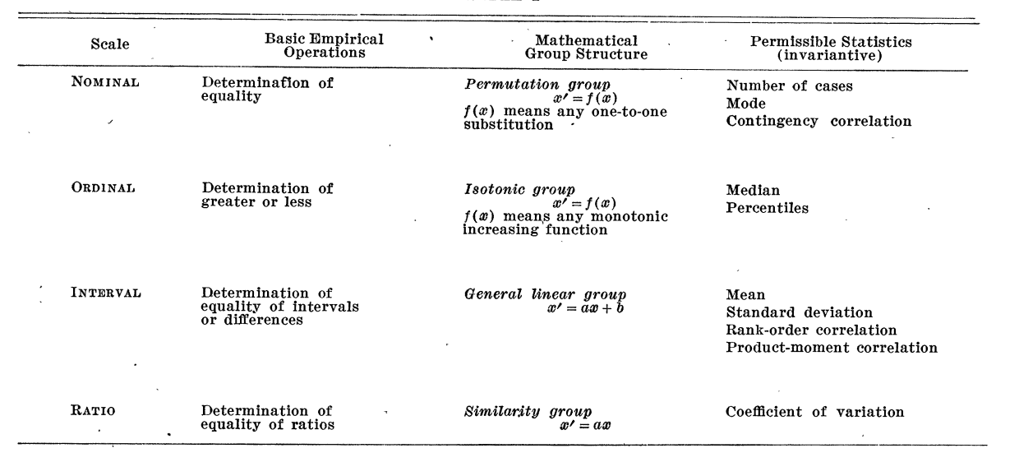
Scales of Measurement1
Quantitative (Interval and Ratio)
Ordinal
Nominal
1 S. S. Stevens, Science, New Series, Vol. 103, No. 2684 (Jun. 7, 1946), pp. 677-680

Slide 38
Grammar of Data

Slide 39
Grammar of Data
Been there for a while (SQL, Pandas), formalized in dplyr2
  provide simple verbs for simple things. These are functions corresponding to common data manipulation tasks.
  second idea is that backend does not matter. Here we constrain ourselves to Pandas.
  multiple backends implemented in Pandas, Spark, Impala, Pig, dplyr, ibis, blaze
2 Hadley Wickham: https://dplyr.tidyverse.org/

Slide 40
Grammar of Data
Why bother?
learn how to do core data manipulations, no matter what the system is.
relational databases critical for non-memory fits.
one off questions: google, stack-overflow, http://chrisalbon.com

Slide 41
http://chrisalbon.com
For cleaning and for transformation:

Slide 42
Grammar of Data
Example: Candidates

Slide 43
Grammar of Data
Contributors

Slide 44
Grammar of Data
Operations:
QUERY: dfcwci[(dfcwci.state=='VA') & (dfcwci.amount < 400)]
SORT: dfcwci.sort_values(by="amount", ascending=False)
SELECT-COLUMNS: dfcwci[['first_name', 'amount']]
SELECT-DISTINCT: dfcwci[['last_name','first_name']].drop_duplicates()
ASSIGN: dfcwci['name']=dfcwci['last_name']+", "+dfcwci['first_name']
ASSIGN(in-place): dfcwci.loc[dfcwci.state=='VA', 'name']="junk”
AGGREGATE: dfcwci.amount.max(), dfcwci.describe()
DELETE: del dfcwci['name'] (DROPCOLUMN)

Slide 45
Grammar of Data
Split-Apply-Combine:
GROUP-AGG
splitting the data into groups based on some criteria
applying a function to each group independently
combining the results into a data structure

Slide 46
Grammar of Data
RELATIONSHIPS (in addition to rubric)
we usually need to combine data from multiple sources
different systems have different ways, most copy SQL (pandas)
sub-select:
  obamaid=dfcand.query("last_name=='Obama'")['id'].values[0]
  obamacontrib=dfcwci.query("candidate_id==%i" % obamaid)

Slide 47
Grammar of Data
JOINS:
combine tables on a common key-value
90% of the time, EXPLICIT INNER JOIN

Slide 48
Python web scraping

Slide 49
Python data scraping
Why scrape the web?
vast source of information, combine with other data sets
companies have not provided APIs
automate tasks
keep up with sites
fun!

Slide 50
Python data scraping
copyrights and permission:
  be careful and polite
  give credit
  care about media law
  don't be evil (no spam, overloading sites, etc.)

Slide 51
Python data scraping
Robots.txt
  specified by web site owner
  gives instructions to web robots (aka your script)
  is located at the top-level directory of the web server
  e.g.: http://google.com/robots.txt

Slide 52
HTML
angle brackets
should be in pairs, eg <p>Hello</p>
void elements do not need a closing tag, for example <br>
<!DOCTYPE html>
<html>
  <head>
  <title>Title</title>
  </head>
  <body>
  <h1>Body Title</h1>
  <p>Body Content</p>
</body>
</html>

Slide 53
Developer Tools
ctrl/cmd shift- i in chrome
cmd-option-i in safari
look for "inspect element"
locate details of tags

Slide 54
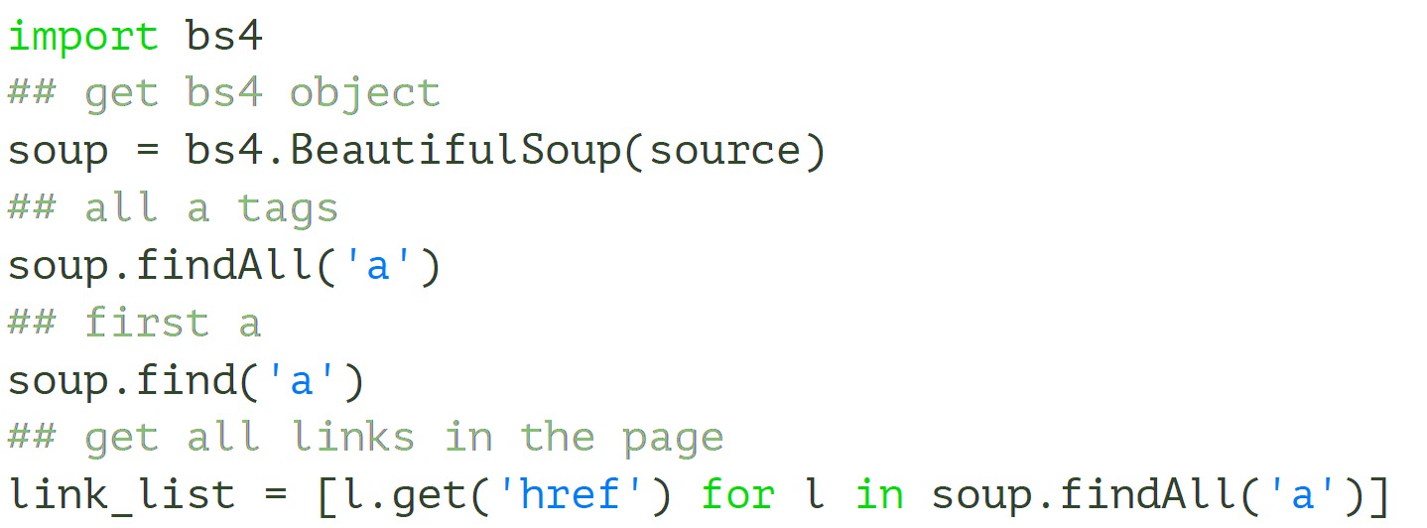
Beautiful Soup
will normalize dirty html
basic usage

Slide 55
HTML is a tree
tree = bs4.BeautifulSoup(source)
## get html root node
root_node = tree.html
## get head from root using contents
head = root_node.contents[0]
## get body from root
body = root_node.contents[1]
## could directly access body
tree.body

Slide 56
Demographics table we want

Slide 57
Table with sole class wikitable

Slide 58
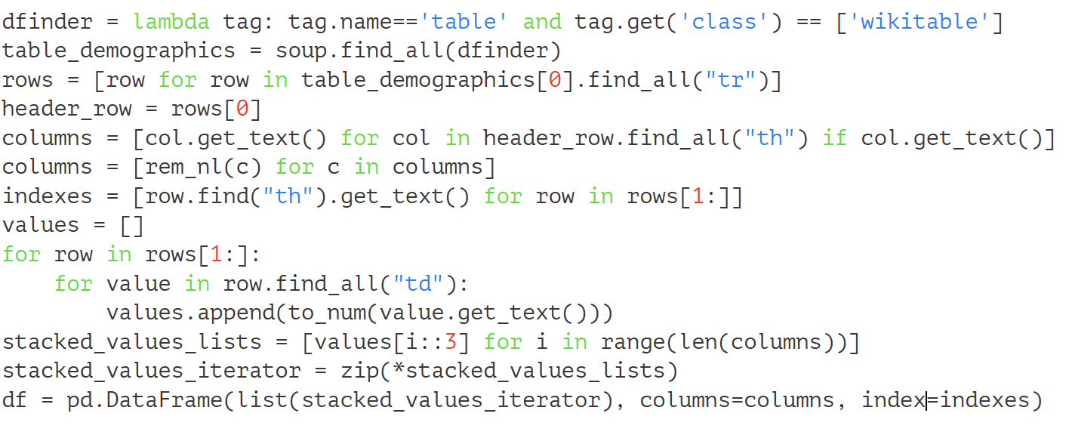
Beautiful Soup Code

Slide 60
Web scraping in 2026
Reliable collection starts with a contract, not a selector copied from DevTools
The earlier slides explain HTML and Beautiful Soup. This update adds the engineering controls needed when the page, network, or schema changes.
Learning outcome: collect an allowed page, validate its records, preserve evidence, and fail safely.
Live lab • warin.me/Courses/Data-Science-and-Engineering/scraping-live-lab/
Notes:
Transition slide for the 2026 update. The live lab uses a local simulated source and does not contact third-party websites.

Slide 61
The scraping contract
Decide what may be fetched and what a valid batch means before writing parser code
Question | Evidence to keep
May we collect it? | Terms, licence, robots.txt, owner approval
Which page is allowed? | Host allowlist and canonical URL
What is one record? | Schema, types and composite key
How fresh must it be? | Schedule, source timestamp and retrieval time
What happens on failure? | Retry policy, quarantine and alert owner
Notes:
Robots Exclusion Protocol is standardized in RFC 9309. Robots rules do not replace copyright, privacy, terms of service, or authorization checks. Source: https://www.rfc-editor.org/rfc/rfc9309.html

Slide 62
A robust request
Network failures are expected inputs to the pipeline
r = requests.get(
url,
timeout=(3.05, 15),
headers={"User-Agent": USER_AGENT},
allow_redirects=False,
)
r.raise_for_status()
Timeouts bound waiting time
raise_for_status() exposes 4xx and 5xx responses
429 requires Retry-After or exponential backoff
Validate redirects and destinations to reduce SSRF risk
Retry only transient failures. Do not retry malformed data into the database.
Notes:
Requests documents timeout exceptions and raise_for_status(): https://requests.readthedocs.io/en/latest/user/quickstart/ . OWASP SSRF prevention recommends validating destinations and handling redirects carefully: https://cheatsheetseries.owasp.org/cheatsheets/Server_Side_Request_Forgery_Prevention_Cheat_Sheet.html

Slide 63
Selectors are assumptions
A successful HTTP response can still contain the wrong page
Approach | Failure mode | Control
Regex over HTML | Breaks on nesting and markup changes | Parse the DOM
Copied nth-child selector | Breaks when rows or wrappers move | Prefer stable id or data attribute
First table on page | Silently selects a new table | Assert headers and expected identity
Text split by commas | Corrupts commas inside values | Read cells and normalize types
Notes:
Beautiful Soup supports CSS selectors with select() and select_one(). Source: https://www.crummy.com/software/BeautifulSoup/bs4/doc/

Slide 64
Validation before storage
Fail closed when the source violates the contract
Check | Example failure | Action
Schema | kWh renamed to Energy | Quarantine batch
Type and range | negative kWh or invalid date | Reject row or batch by policy
Uniqueness | duplicate date and client_id | Stop; investigate pagination or source
Completeness | expected clients disappear | Alert source owner
Reconciliation | page says 500 rows, parser sees 487 | Preserve raw HTML and stop
Notes:
Teaching prompt: ask which checks apply to one row, one page, and the complete batch.

Slide 65
Live lab: six controlled failures
The local source makes failure reproducible and safe
Scenario | Expected observation
Stable HTML | Three records pass every check
CSS class changed | Selector finds nothing; parser stops
Column renamed | Schema contract fails
Missing value | Quality rule quarantines the batch
Duplicate key | Uniqueness check catches repeated record
HTTP 429 | Fetcher waits and retries according to policy
Open: /Courses/Data-Science-and-Engineering/scraping-live-lab/
Notes:
Run scenarios in order. Ask students to predict the failing pipeline stage before clicking Run.

